Slide 1
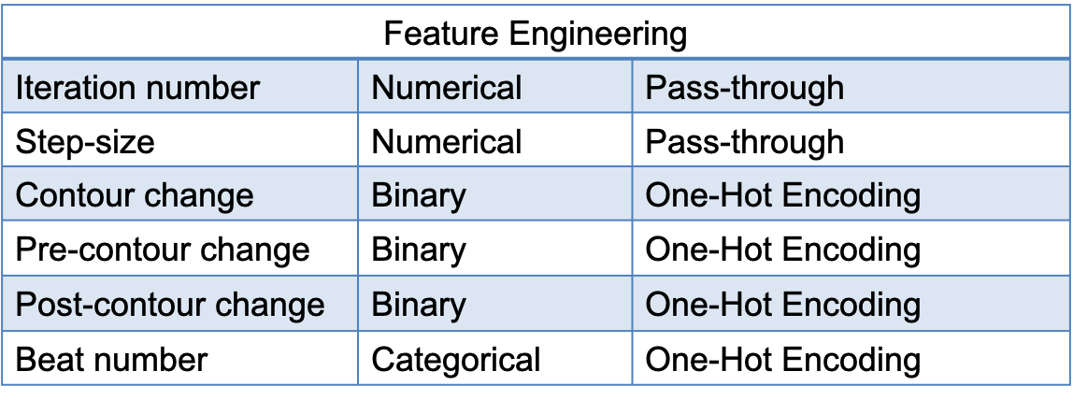
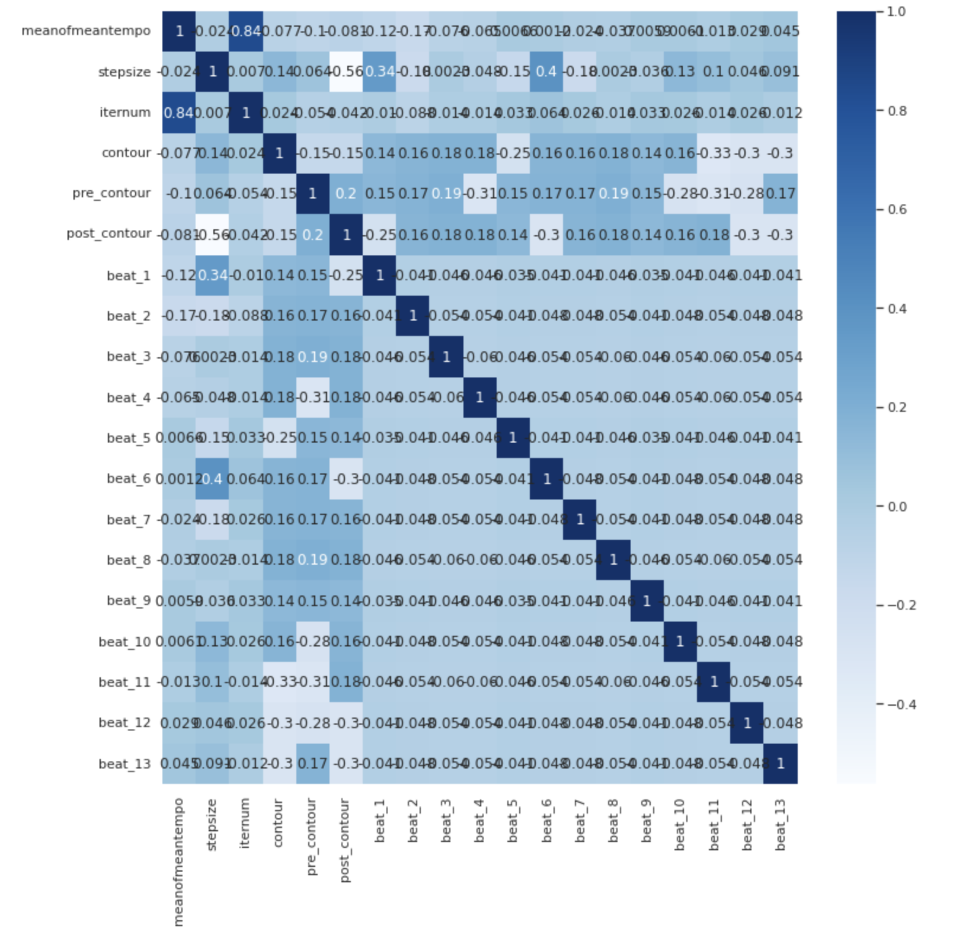

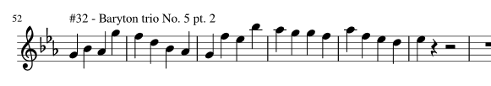
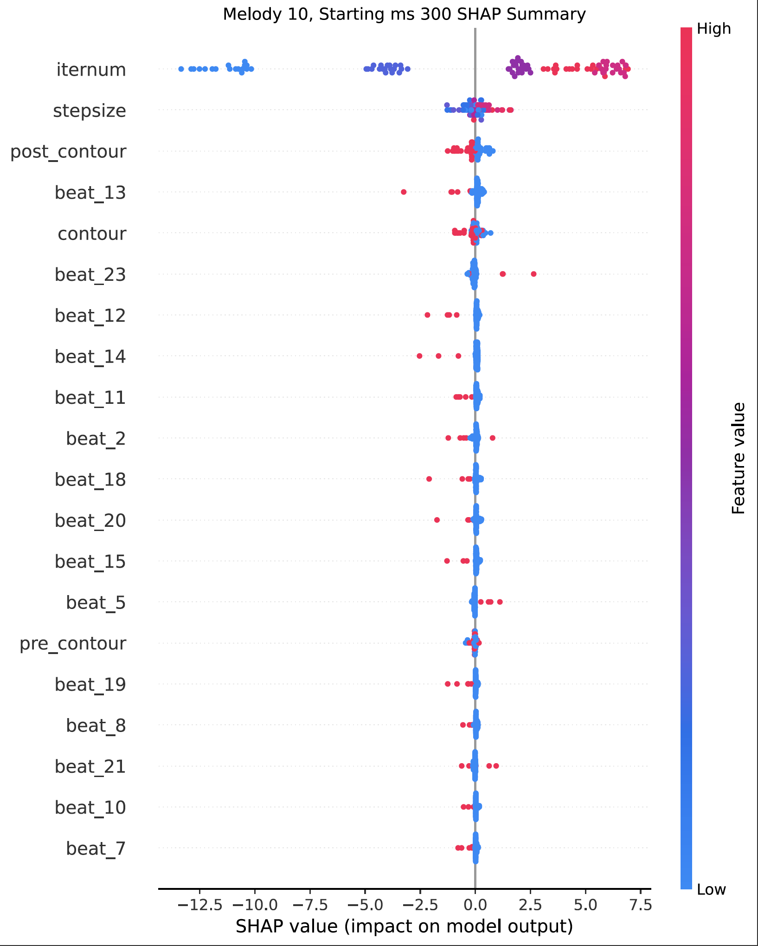
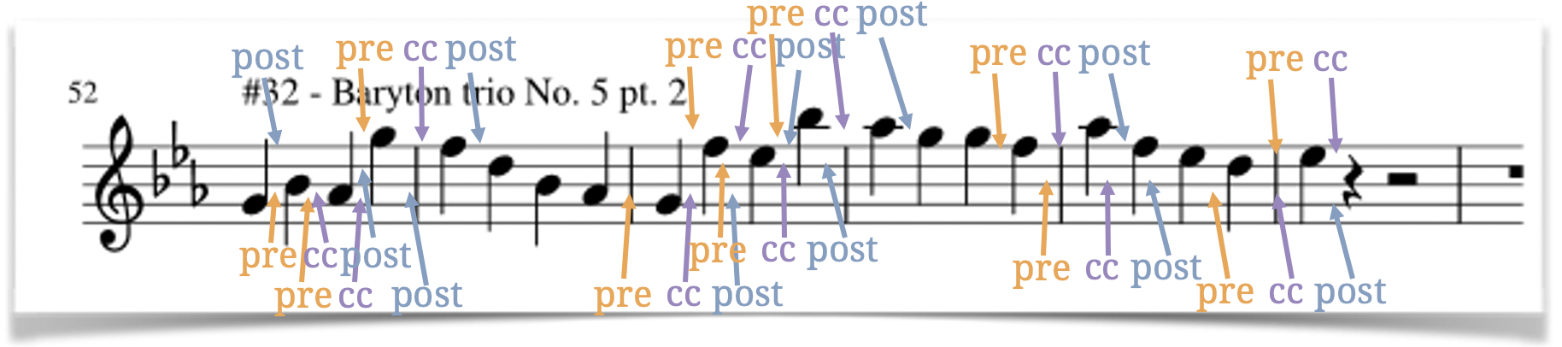
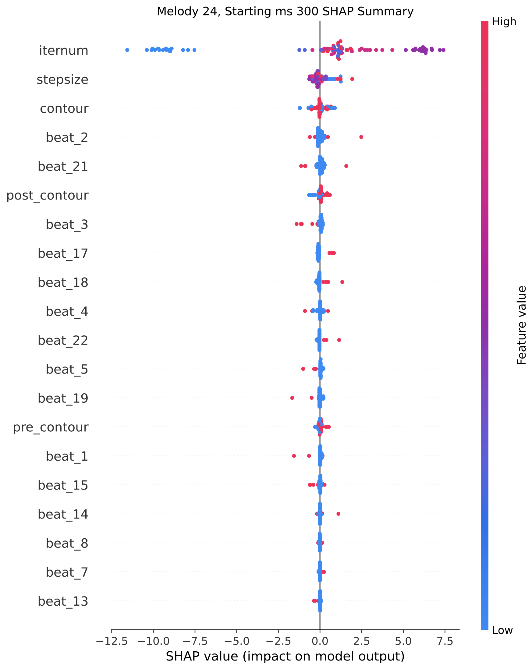
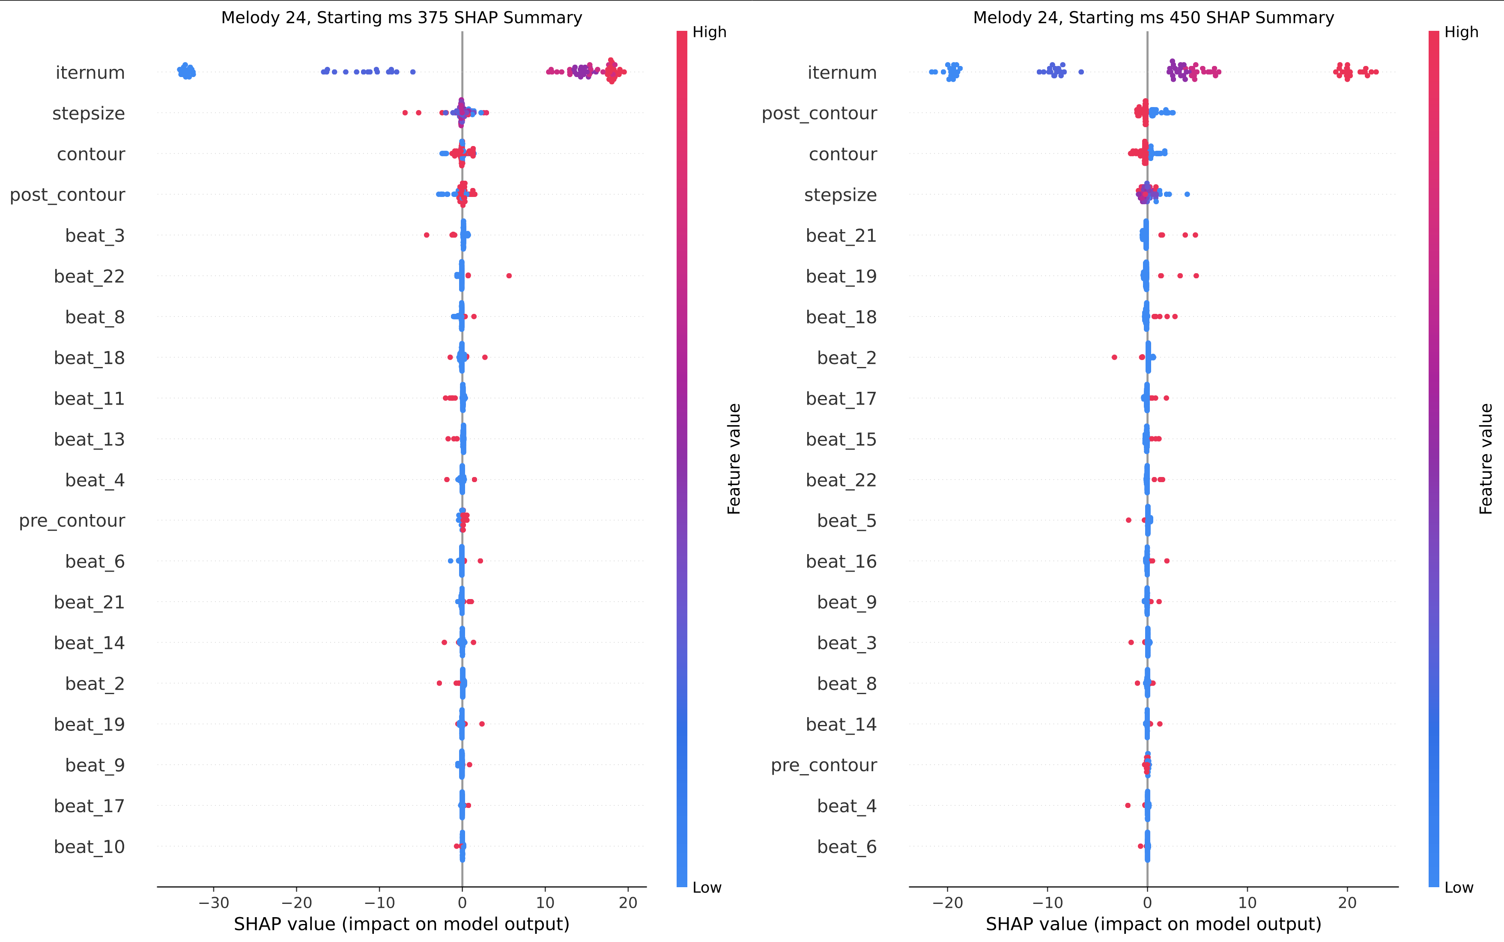
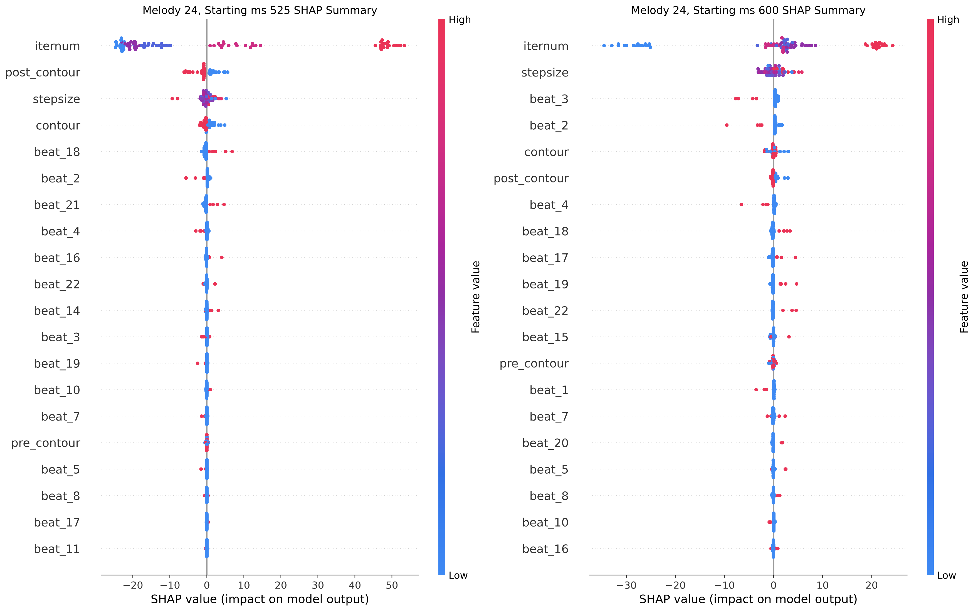
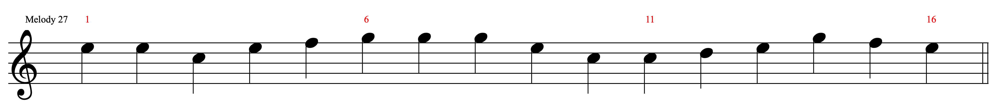
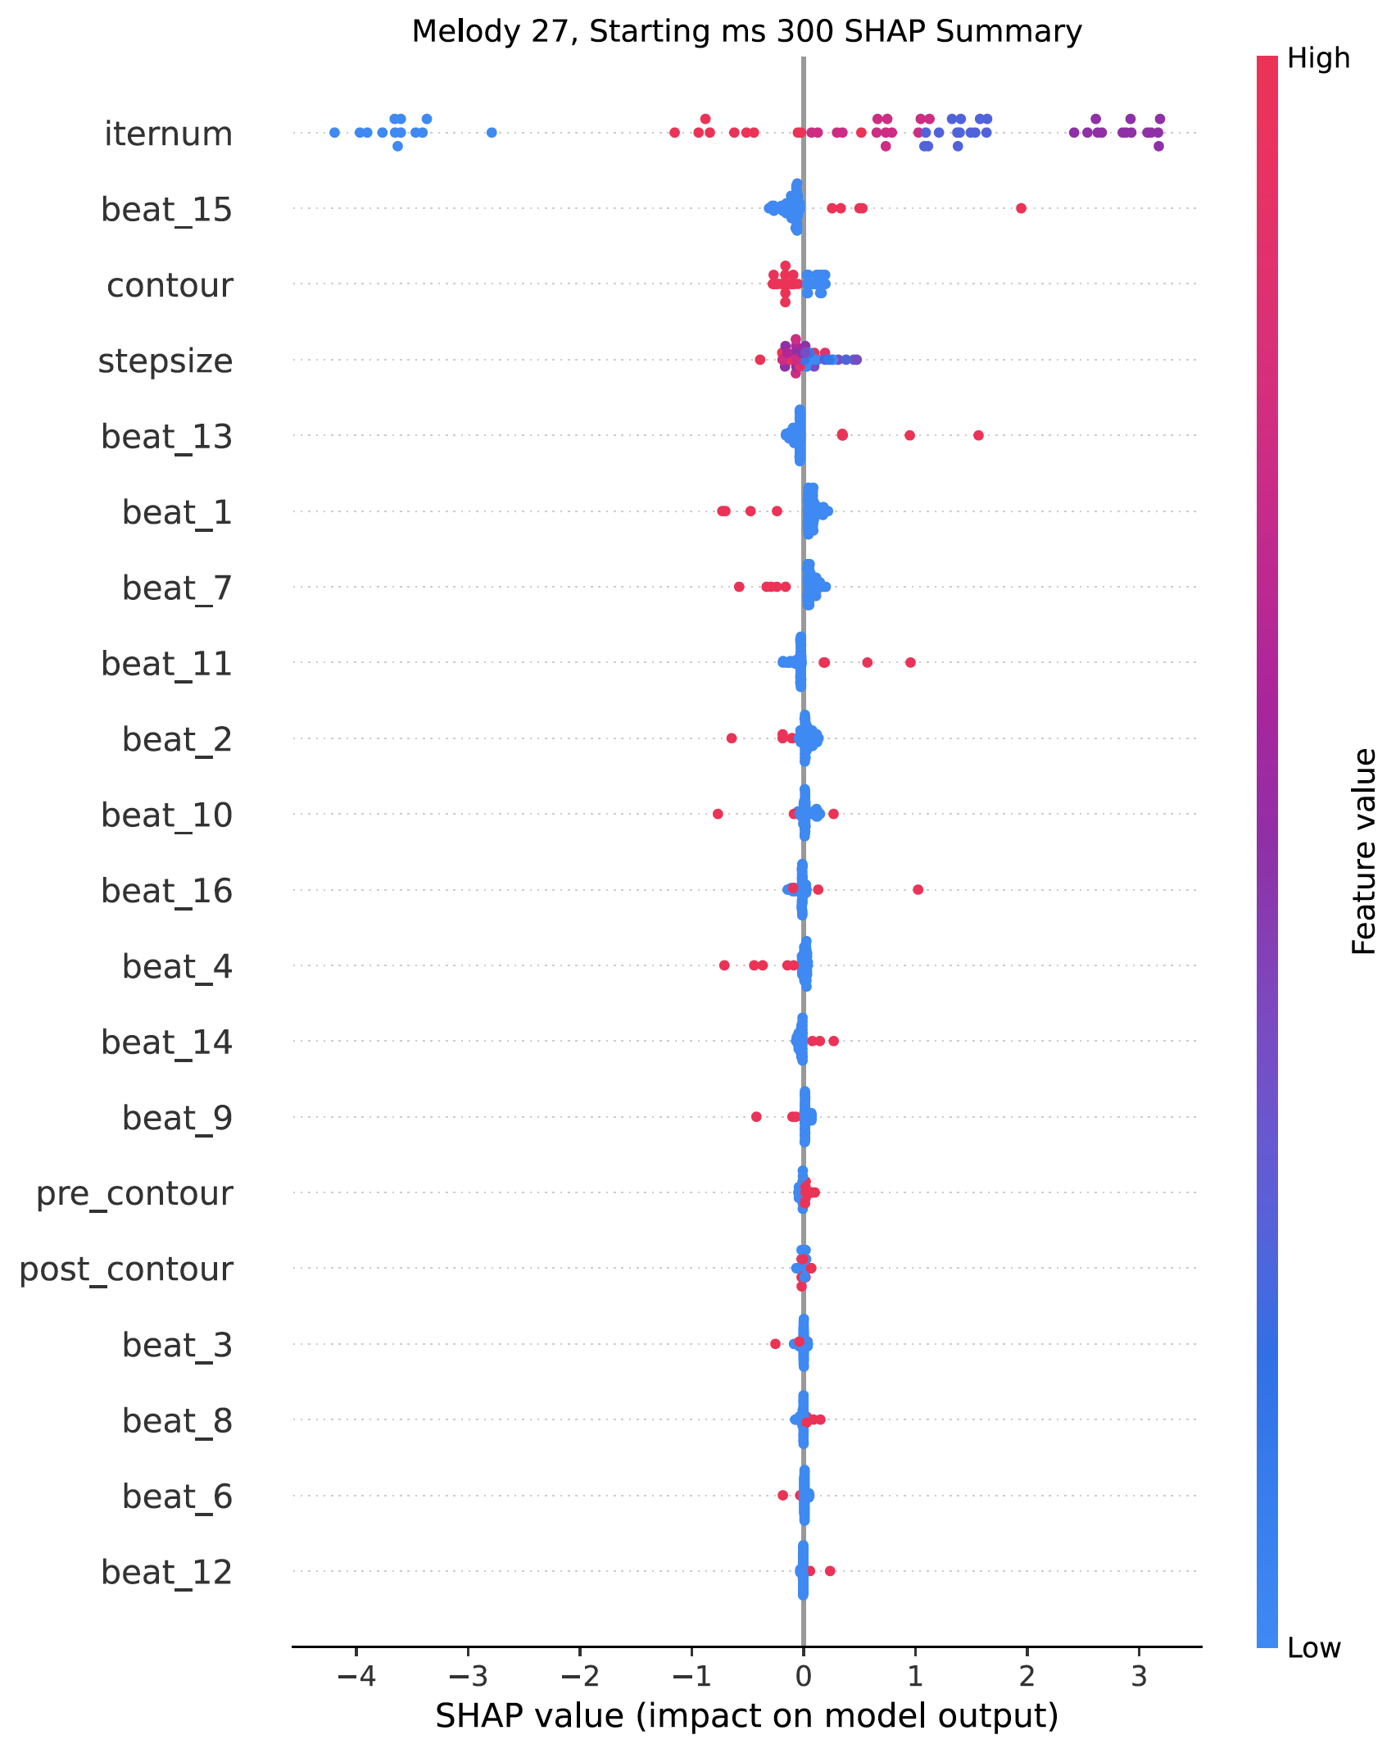
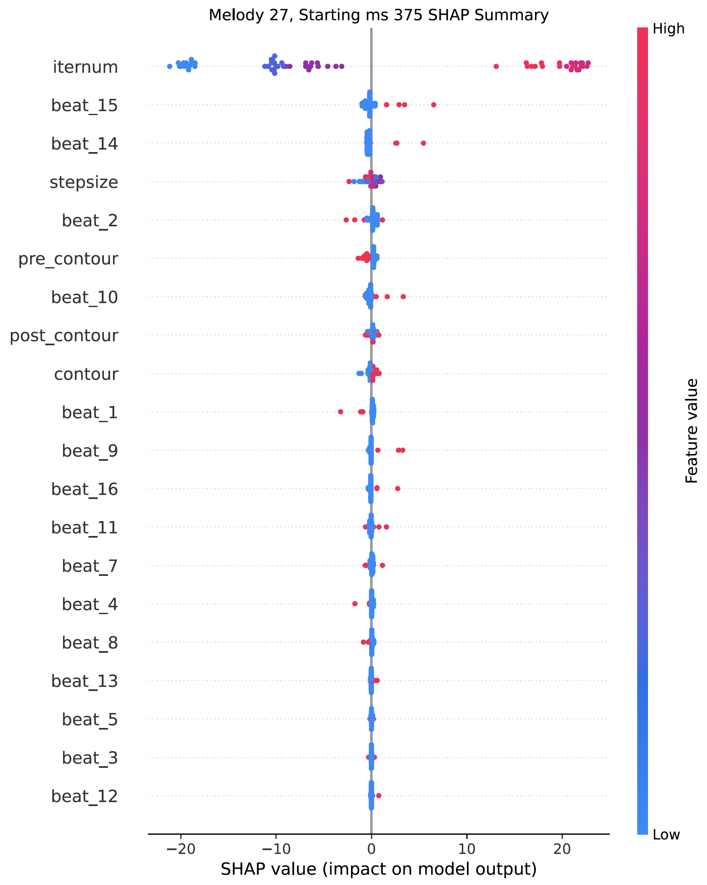
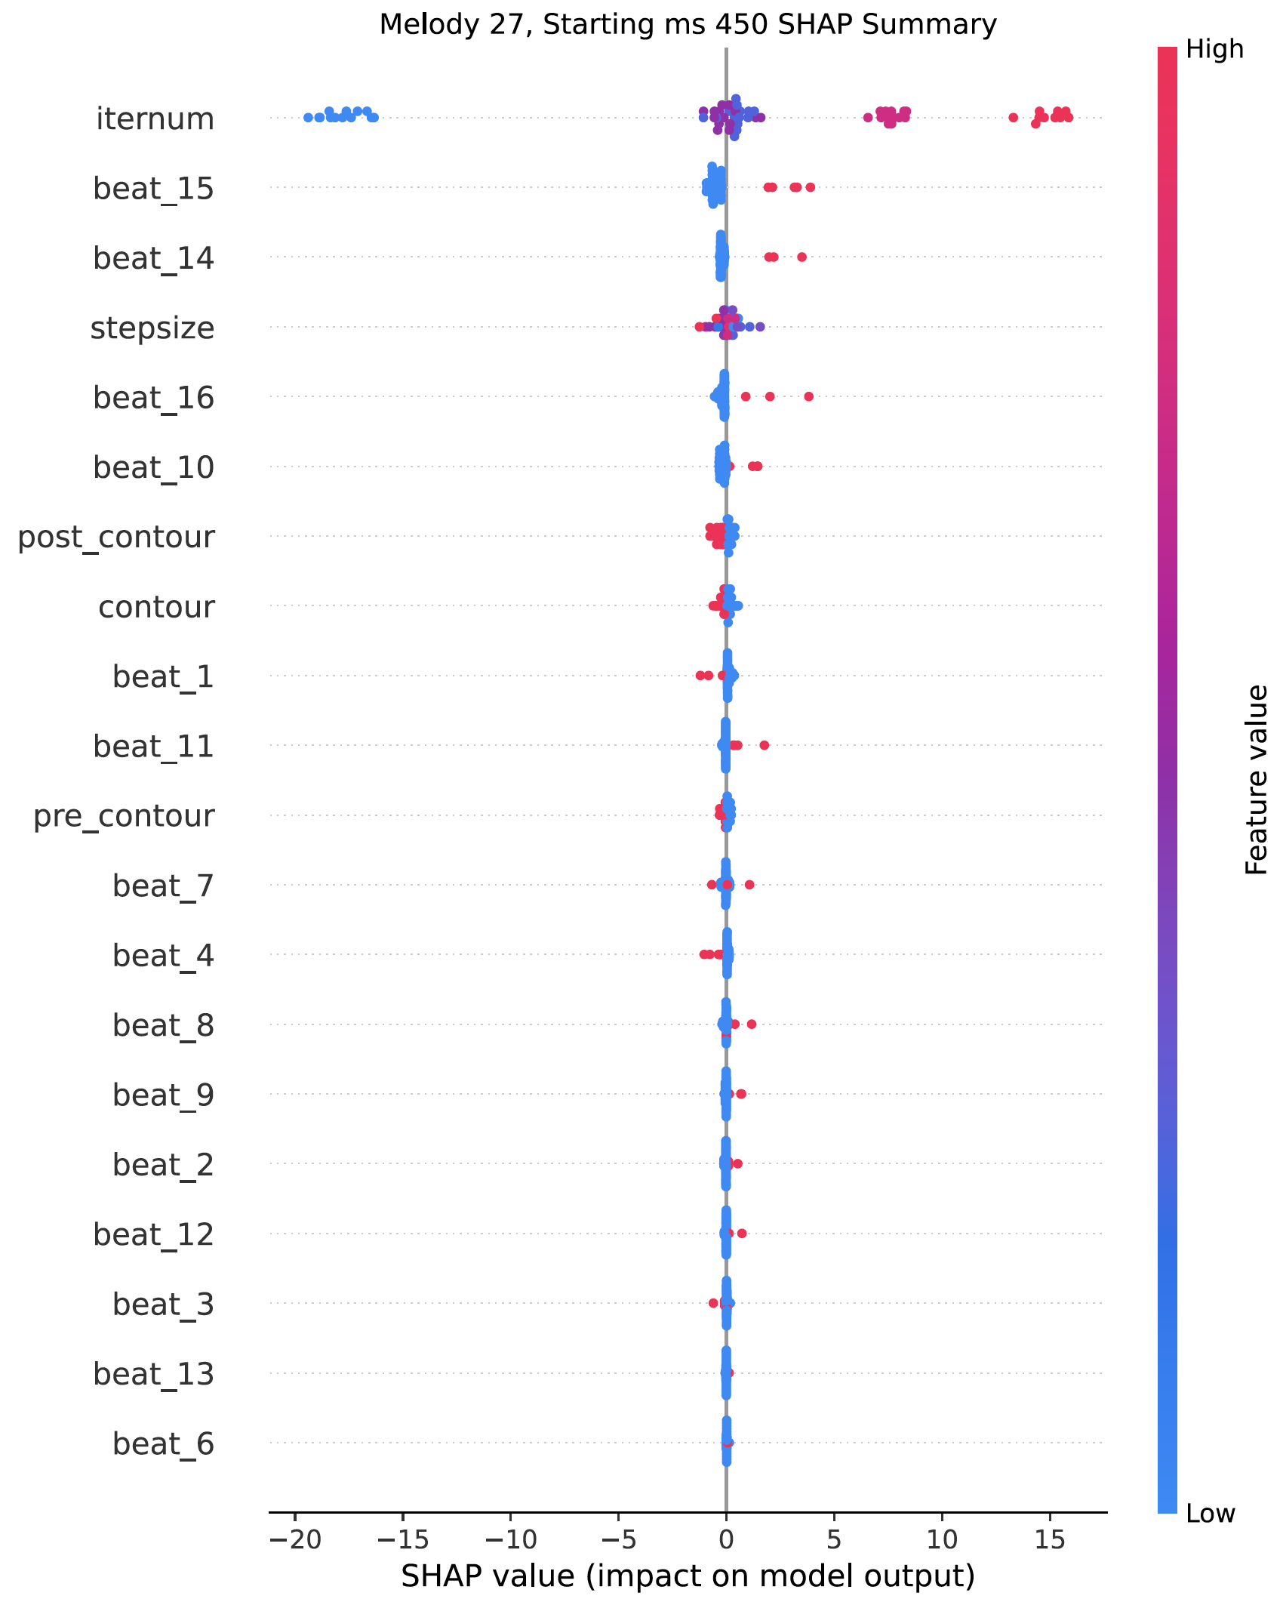
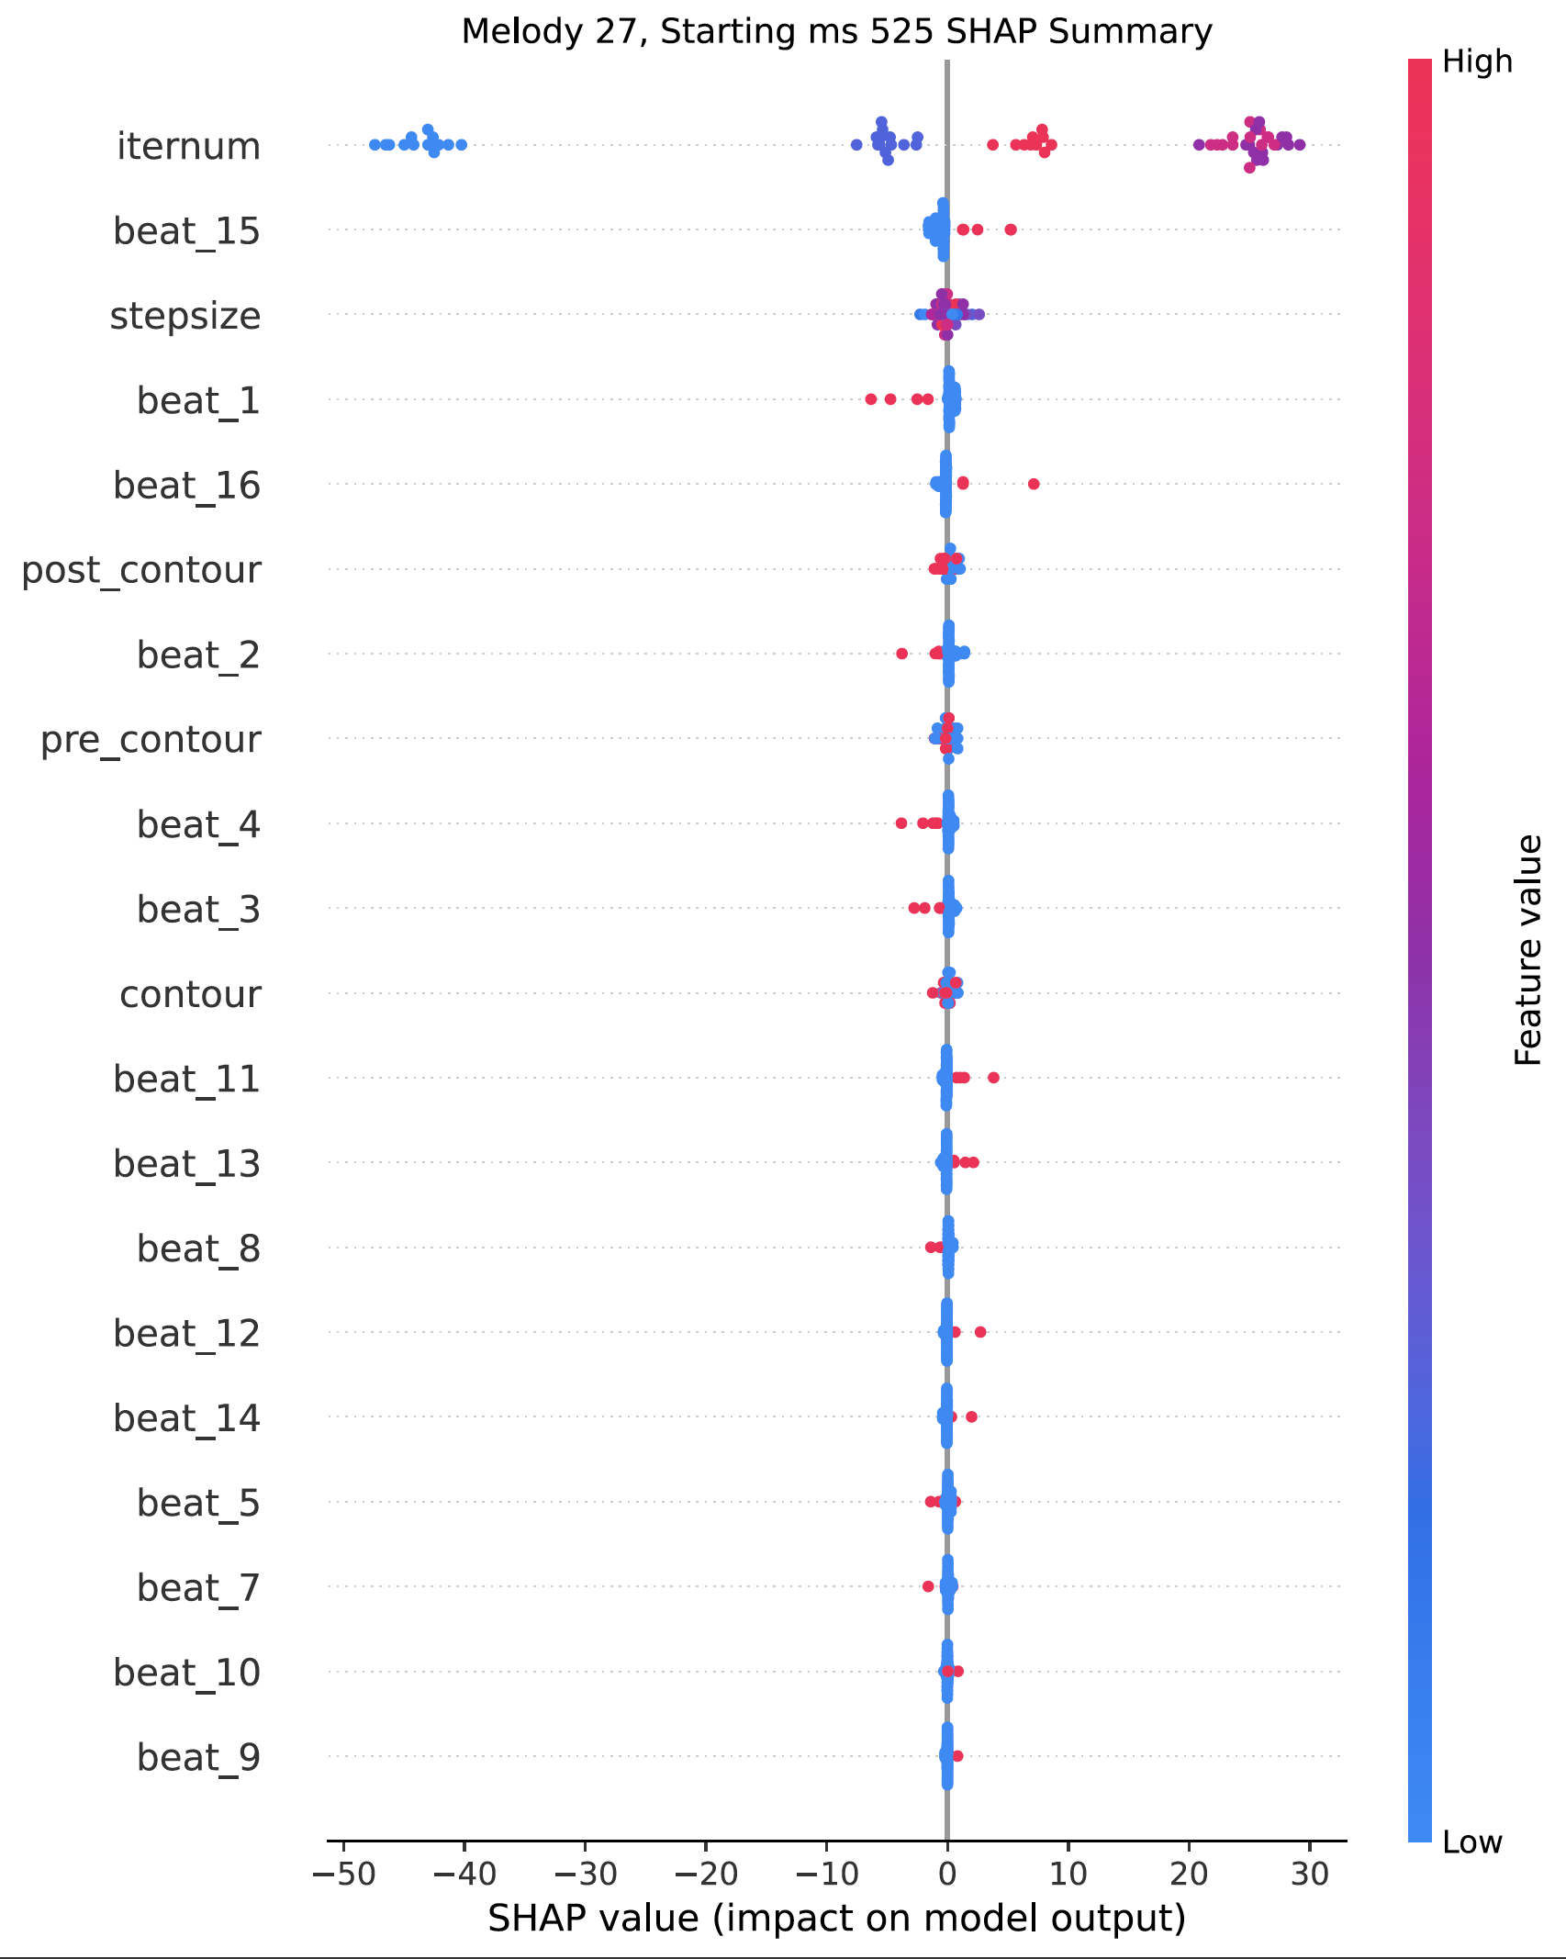
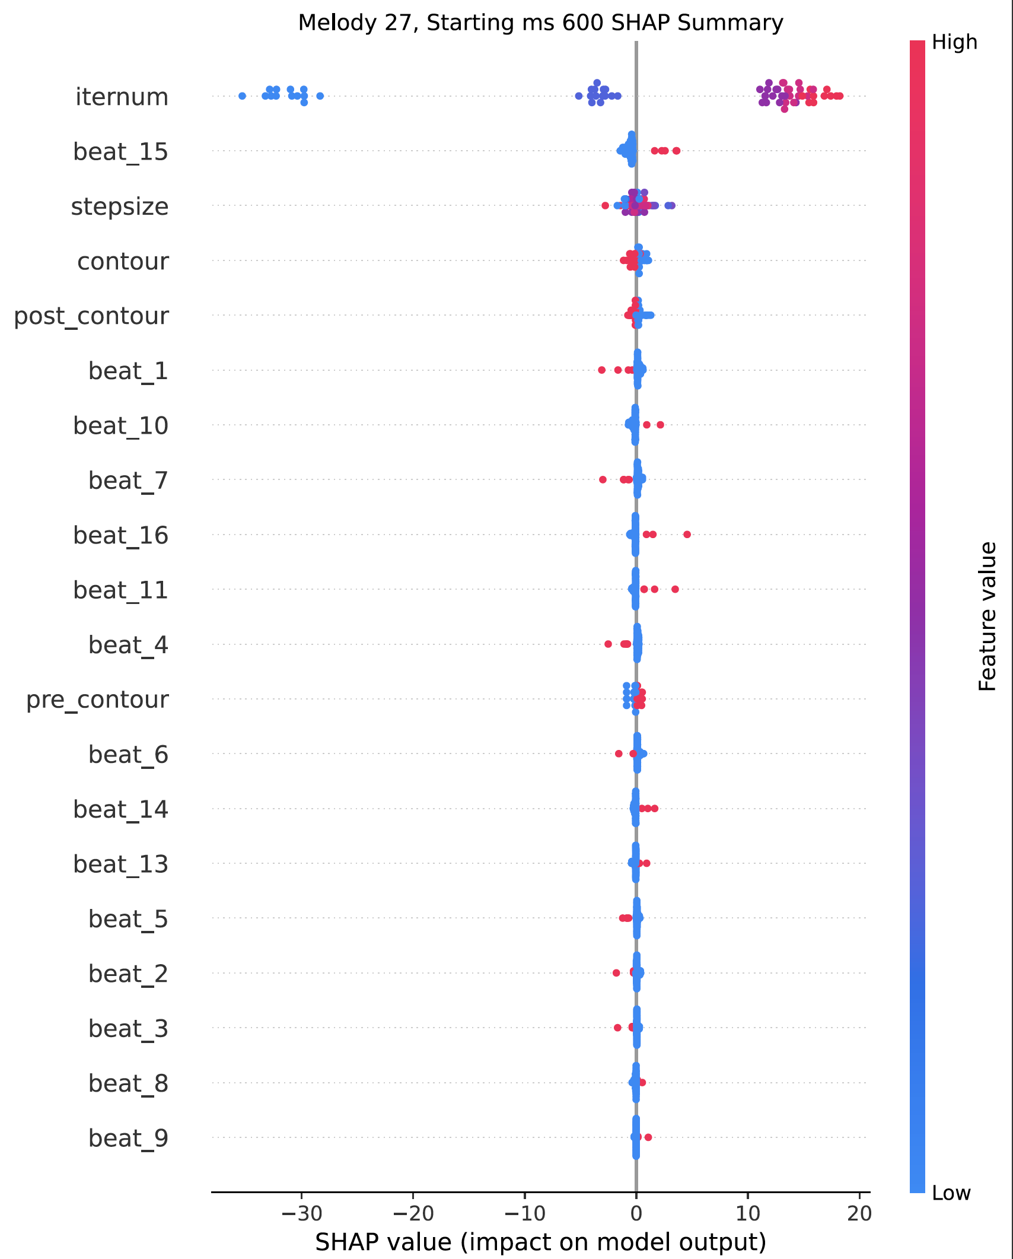
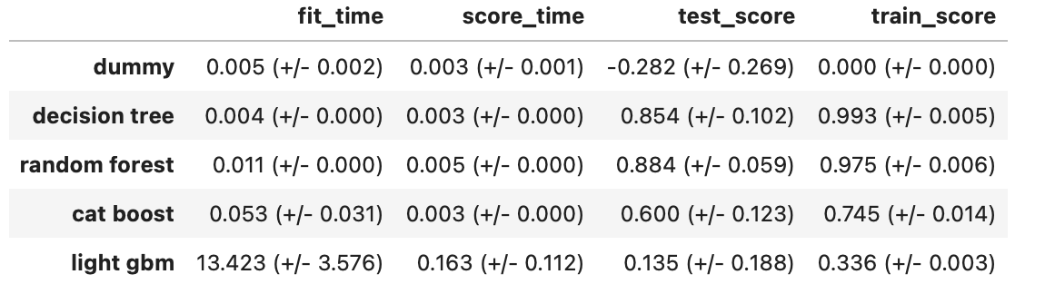
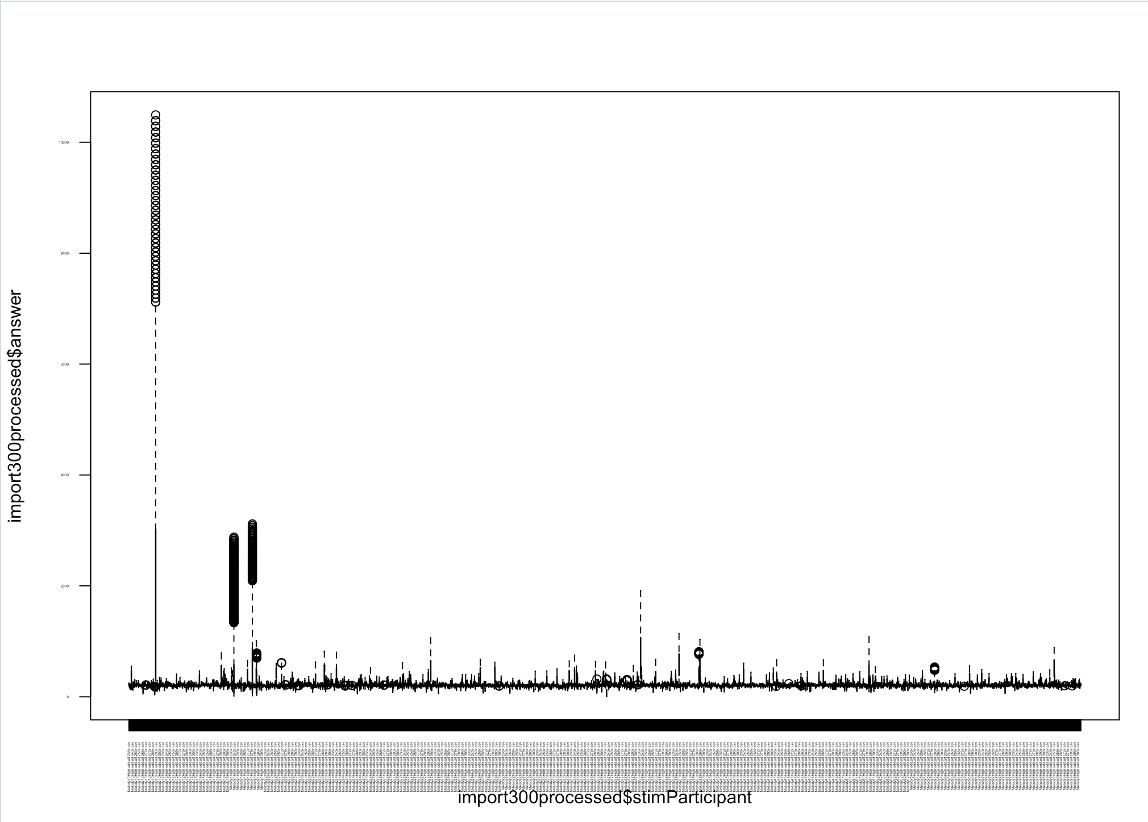
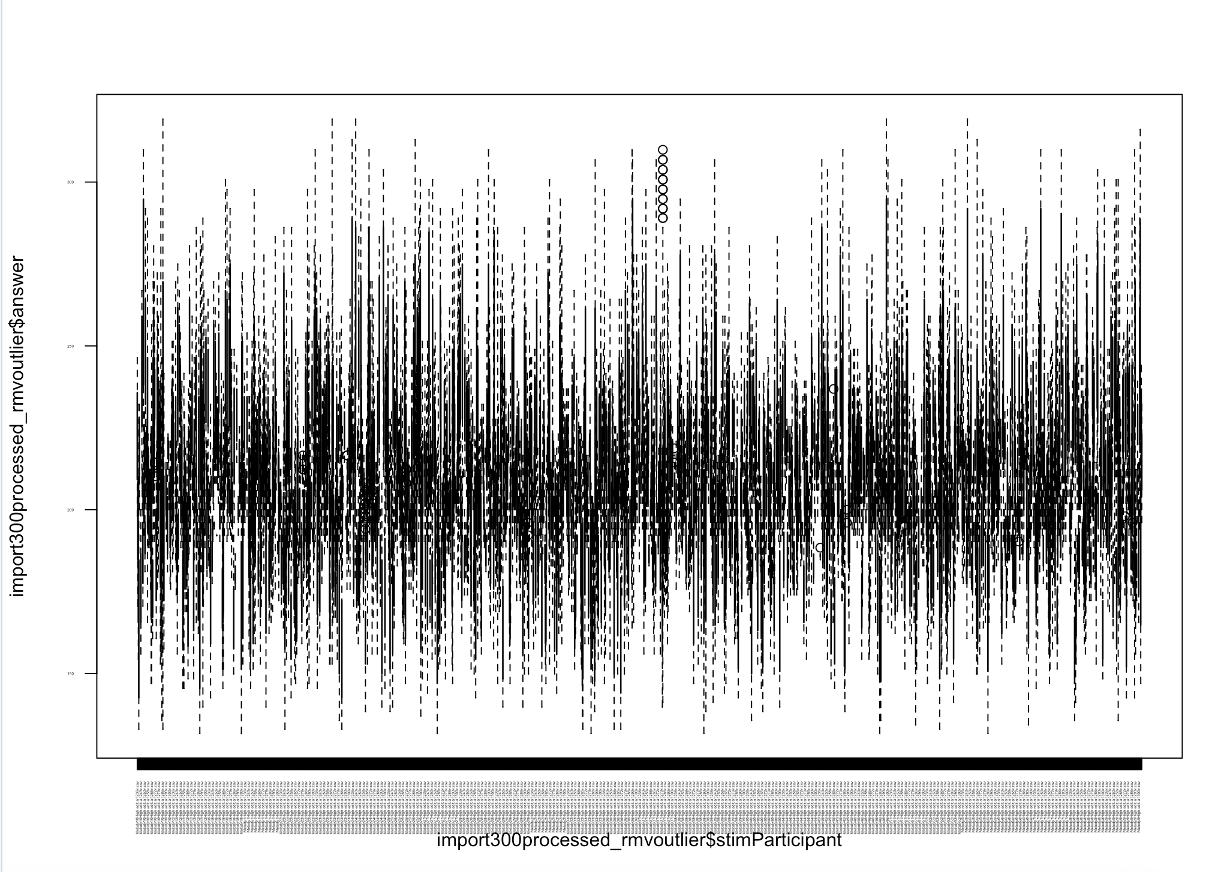
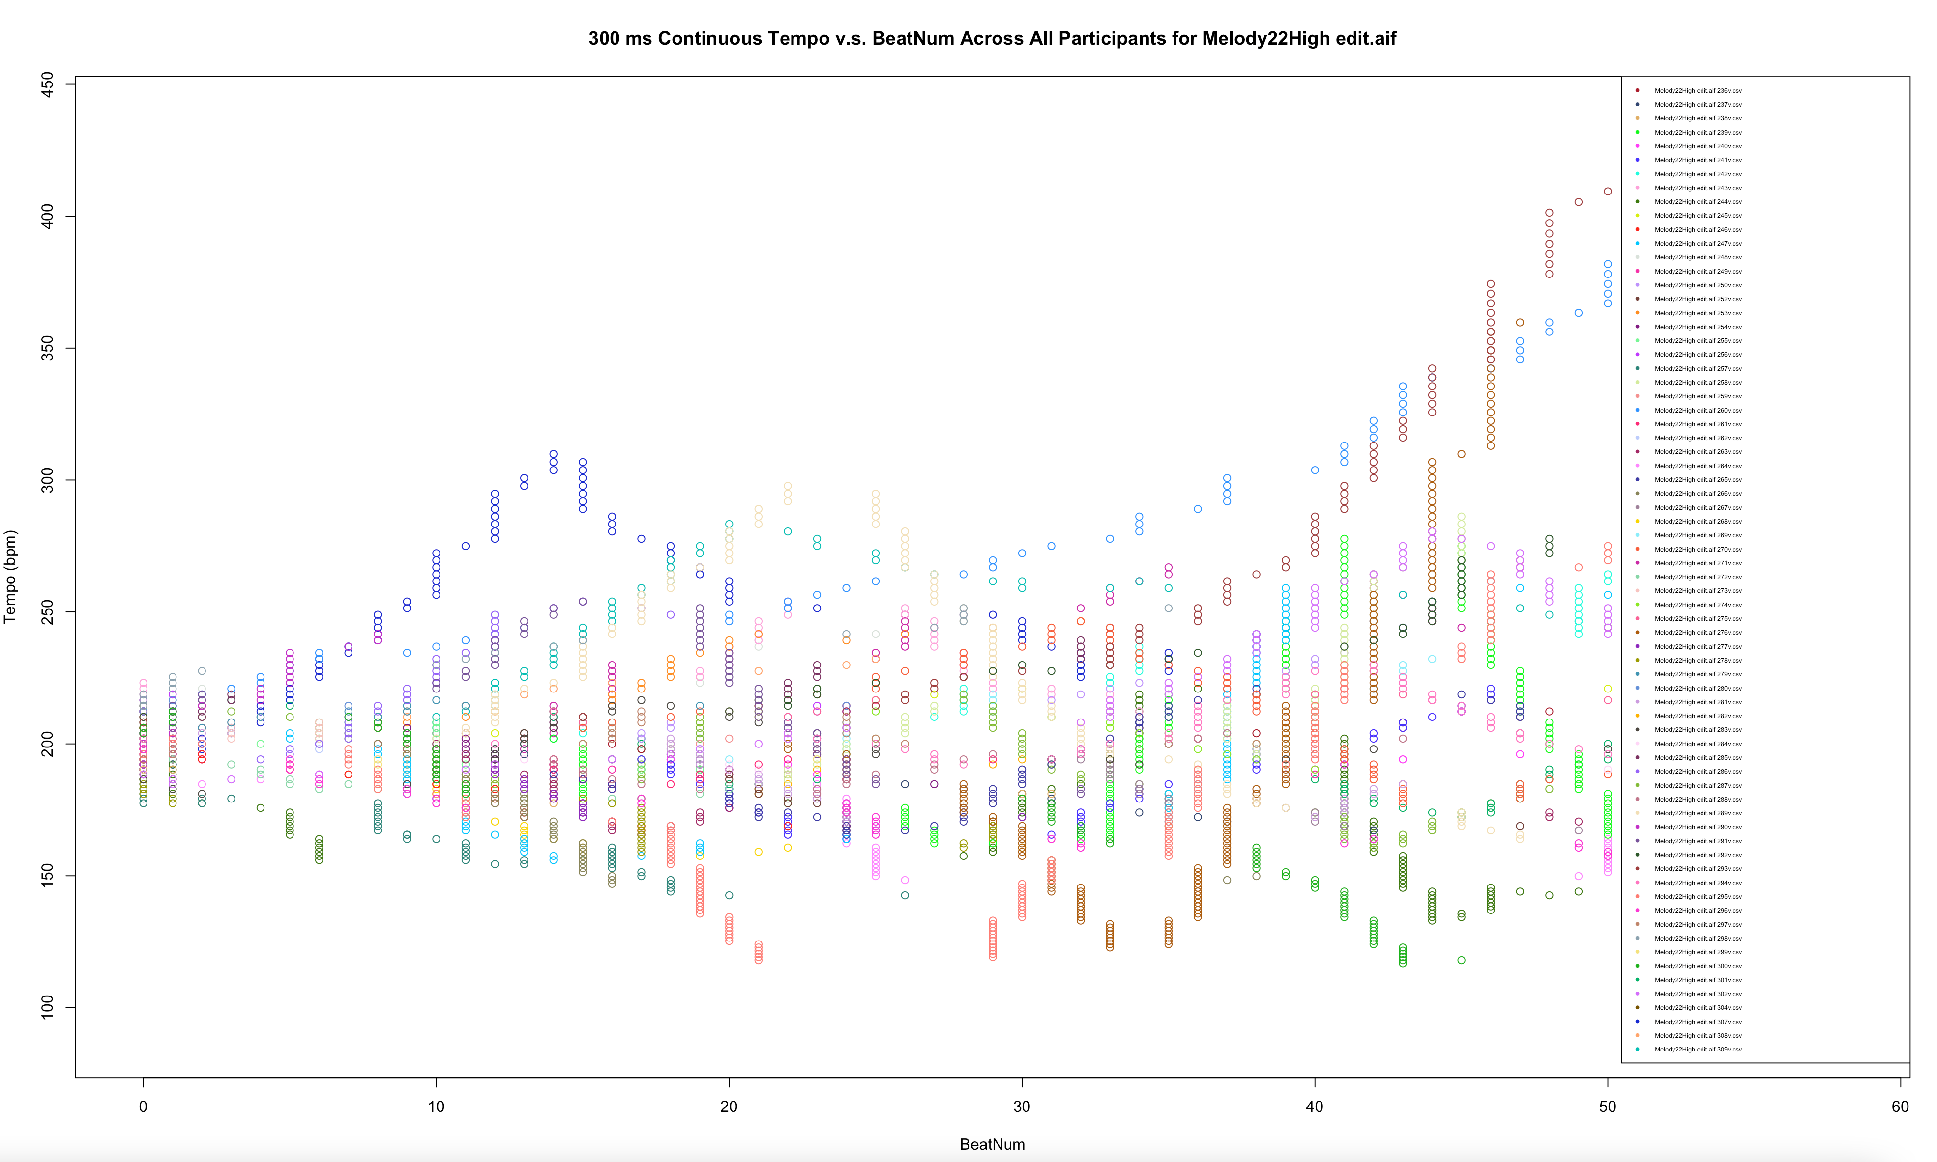
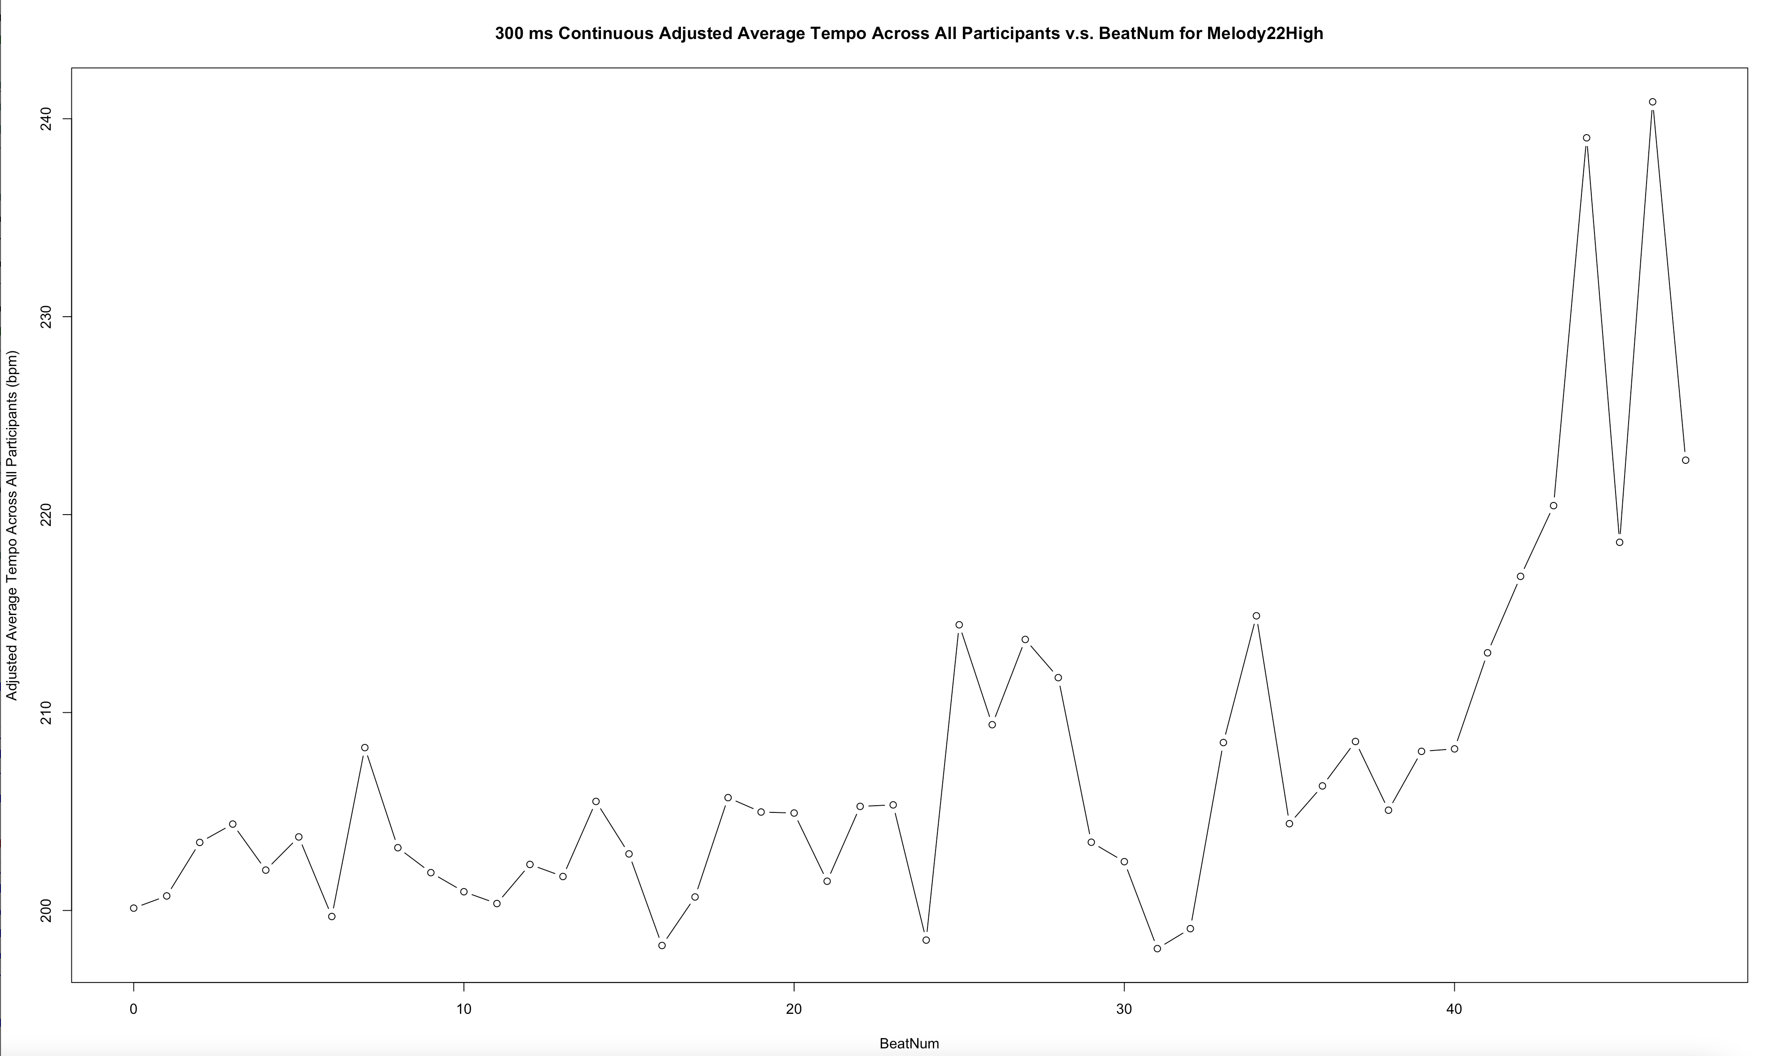
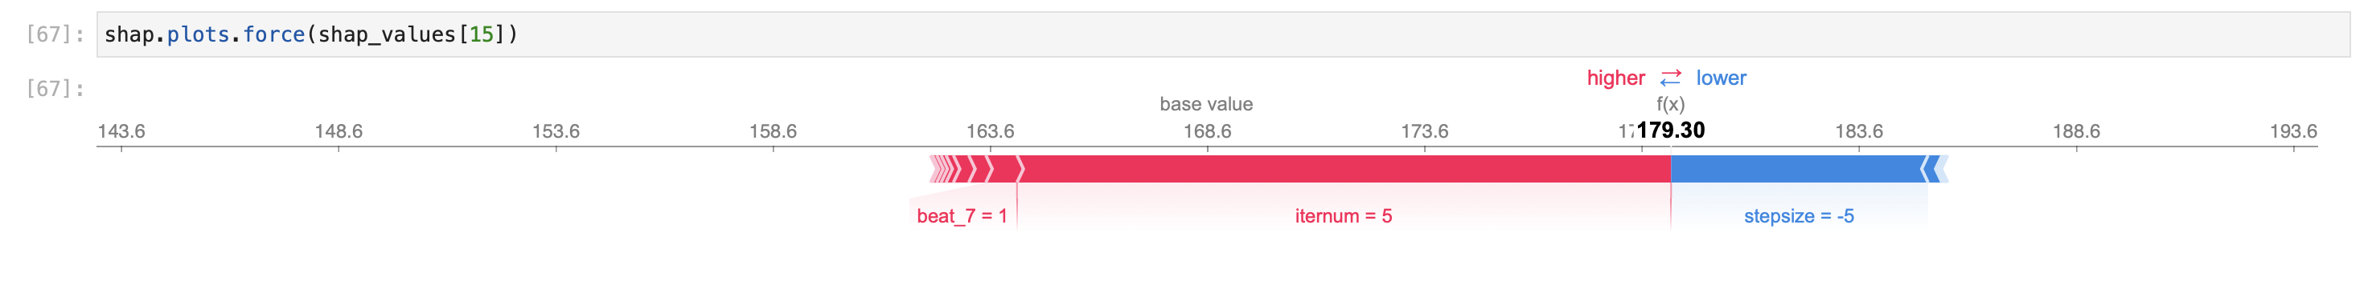


Explaining Melodic Characteristic Effects on Tempo Determination with a Machine Learning Model
Meiying Ding*†, Leigh VanHandel*
*Faculty of Arts †Faculty of Science
University of British Columbia
Introduction
This is part of a larger project investigating tempo determination, or the real-time process of determining an appropriate tempo for unfamiliar music based on musical characteristics that act as cues.
Prior studies (VanHandel et al 2018, VanHandel 2021) found that an increase in the number of contour changes or the average interval size within a melody led to a slower overall determined tempo. Followup studies determined that the effects of the melodic characteristics were (starting) tempo dependent. When we looked at contour changes more specifically, separating out pre-contour change intervals and post-contour change intervals, we found that descending intervals as part of a contour change resulted in less consistency at faster tempi and more consistency at slower tempi.
To further investigate the effect of individual melodic characteristics within local points in melodies, we implemented a machine learning model through a Python pipeline that returns SHAP feature importance values and visualizations across 22 melodies and 5 starting tempi.
Data Cleansing, Exploratory Analysis, and Visualization
Each of 232 participants listened to looped recordings of at least 22 isochronous melodies at a starting tempo (300ms, 375ms, 450ms, 525ms, or 600ms) and used an Arduino spin wheel to adjust the tempo to decide on a “correct” tempo. We rounded participants’ continuous recorded tempo to the closest beat in order to calculate the average tempo at common time points.
sklearn Proprocessing Pipeline
Comparing Different Models
Using 5-fold cross validation on the training set, we found that using a random forest model with appropriate hyperparameter optimization gives the best cross validation accuracy of 88%. Applying the same pipeline to all 107 melody and starting tempo combinations gave an average test accuracy on held-out sets of 70%.
Results and SHAP Summary Plots
From this model, we visualized a SHAP summary plot for each of the 107 starting tempo and melody combinations. These results, alongside further hypothesis testing, provide some additional detail about how musical characteristics may influence tempo determination.
Leap (interval > a third)
Skip (third)
Each SHAP summary plot orders melodic features or events by their importance in tempo determination from top to bottom. Each dot is a single prediction for one instance. Iteration number is the most important feature in tempo determination in all 107 starting tempo and melody combinations. Step size, existence of pre-, post-, or regular contour change also tend to follow in importance.
Simultaneity (leap/skip at contour change)
Contour change
musical characteristics examples
Within the Scikit-learn pipeline, we transformed the above melodic features. Only the first five iterations of each melody are considered to avoid unnecessary noise from later iterations.
Lower numbers for iternum (blue) have highly negative SHAP values, suggesting slower predicted tempi; higher numbers for iternum (red) have highly positive SHAP values, suggesting faster tempi.
At each contour change (red) or post contour change (red), the predicted tempi are pulled to be slower for melody 10 at the 300 ms starting tempo.
In all melodies, a few beats would consistently rank as important across all five starting tempi. For example, beat 18 in Melody 24, which is a downward leap by an octave from beat 17, consistently pulls the tempo predictions to be faster (red dots to the right of zero).
three types of contour changes
The importance of certain beats in different melodies occasionally ranked even higher than the step size, e.g., melody 27, beat 15. Therefore, the model could be used to indicate beats within each melody that are worth further investigation.
With one-sample t-tests, the average effect of beat 1 across all melodies at 4 of the 5 starting tempi tested to be significant in slowing down the tempo at a 95% confidence level. This suggests participants tend to slow down the tempo at the beginning of every iteration. Beat 1’s significance in slowing down the tempo is increasingly more evident as the starting tempo gets slower.
H_{o}: Average SHAP value of beat one for each starting tempo is zero; beat 1 is not significant in tempo determination.
H_{A}: Average SHAP value of beat one for each starting tempo is less than zero; beat 1 is significantly slowing down the tempo on average.
Starting Tempo (ms) | P-Value
300 | 0.037
450 | < 0.01
525 | < 0.001
600 | < 0.0001
Decreasing starting tempo;
Increasing significance in
slowing down the tempo
SHAP Values
The SHapley Additive exPlanations values (Shapley 1953) provide a unified framework for interpreting how much each feature value contributes to the prediction compared to the average prediction. Using Python’s SHAP package, we can explain the output value corresponding to each melodic feature from the random forest model.
Discussion
This model allows us to zoom in on melodic features within each melody that act as forces in the continuous slowing or speeding of tempo. The 107 SHAP summary plots could be detailed pathways towards insights on the influence of further features such as repeated notes, leaps, stepwise ascents/descents in determining tempo. Future work could involve time series that account for seasonality over iterations for each melody, or Seemingly Unrelated Regression that combines all five starting tempi in one regression model.
References
Boltz, M. 1988. “Tempo discrimination of musical patterns: effects due to pitch and rhythmic structure.” Perception and Psychophysics 60.8: 1357–1373.
Ding, M. 2021. Tempo Determination. GitHub. https://github.com/miyading/tempodetermination
Shapley, L.S. 1953. “A value for n-person games.” Contributions to the Theory of Games 2(28): 307–317.
Slundberg, S.M. 2018. Slundberg/SHAP: A game theoretic approach to explain the output of any machine learning model. GitHub. https://github.com/slundberg/shap
VanHandel, L, 2021. “Melody and rhythm: effects on tempo determination.” Future Directions of Music Cognition Keynote, 5/10/21.
VanHandel, L. Drotos, A., and McAuley, D. 2018. “Relation between melodic characteristics and tempo determination.” Proceedings of the International Conference on Music Perception and Cognition/European Society for the Cognition of Music.
Acknowledgements
Devin McAuley’s Timing, Attention, and Perception Lab provided invaluable assistance and support for this project while LVH was at Michigan State; the project is now being supported by the University of British Columbia.
Special thanks to Dr. Leigh VanHandel for her patient mentoring.
Distribution of Participants’ Recorded Tempo Before and After Outlier Removal, Example for starting tempo of 300 ms. Tempi kept are within a narrower and more reasonable range.
The red features in the SHAP force plot indicate that beat 7 on the 5th iteration drives this local predicted tempo to a faster tempo than the average value of 168.6 bpm. On the contrary, the blue feature indicates that a downward leap of 5 semitones contributes to slowing down the tempo of this prediction. Altogether, this instance in the dataset has a predicted tempo of 179.3 bpm.
Averaged Participants’ Recorded Tempo, Example for start tempo = 300 ms, Melody 22. Here, each iteration has 24 beats. Besides the general trend of speeding up towards later iterations, it is difficult to observe any pattern on specific beats or melodic features. Therefore, further analysis is deployed.
Collaborators

